Slide 1
Feature Selection,
Projection and Extraction
Carla Brodley
Introduction to Machine Learning and Data Mining, Carla Brodley
Notes:
TO DO 4/14/12: Understand what L1-Norm regularization does vs. L2-Norm
Finish PCA Slides

Slide 2
What is the concept?
- banana
+ grapefruit
- firetruck
+ airplane
duck
fire
+ graduation
+ yellow
- basket
+ garden
- class
Introduction to Machine Learning and Data Mining, Carla Brodley

Slide 3
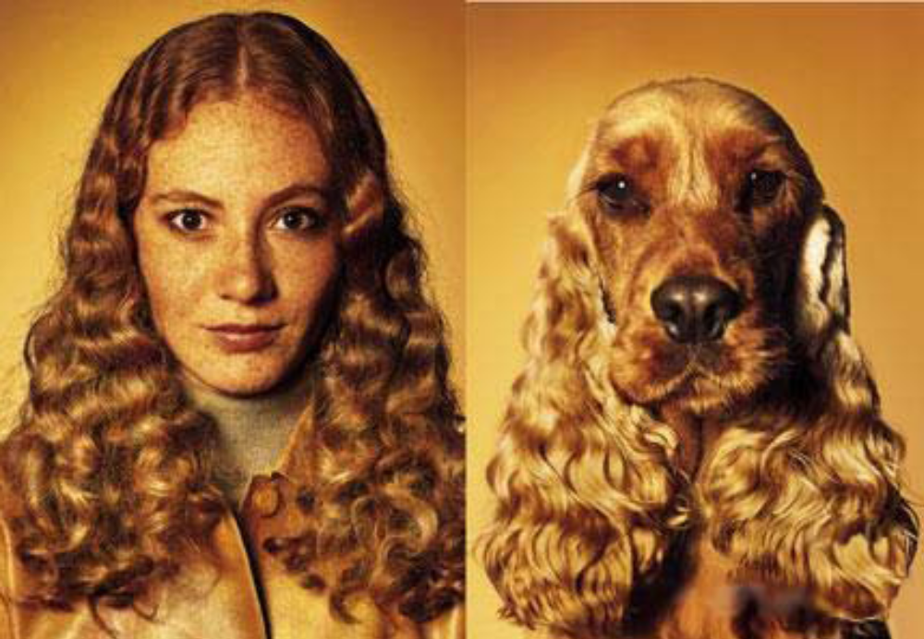
What is Similarity?
Introduction to Machine Learning and Data Mining, Carla Brodley

Slide 4
Classifier Construction
Objective: Construct a classifier for the data such that predictive accuracy is maximized
  1. Prepare/collect training instances
    Generate/select descriptive features
    Collect and label instances
  2. Construct a classifier
Introduction to Machine Learning and Data Mining, Carla Brodley

Slide 5
Creating Features
“Good” features are the key to accurate generalization
Domain knowledge can be used to generate a feature set
  Medical Example: results of blood tests, age, smoking history
  Game Playing example: number of pieces on the board, control of the center of the board
Data might not be in vector form
  Example: spam classification
    “Bag of words”: throw out order, keep count of how many times each word appears.
    Sequence: one feature for first letter in the email, one for second letter, etc.
    Ngrams: one feature for every unique string of n features
Introduction to Machine Learning and Data Mining, Carla Brodley
Notes:
Idea in game playing, is that some features may take a significant amount of computation to find the value.
Poor feature set for most purposes—similar documents are not close to one another in this representation.

Slide 6
What is feature selection?
Reducing the feature space by throwing out some of the features
Introduction to Machine Learning and Data Mining, Carla Brodley
Notes:
Example: soc sec number is known to be poorly correlated with disease.

Slide 7
Reasons for Feature Selection
Want to find which features are relevant
  Domain specialist not sure which factors are predictive of disease
  Common practice: throw in every feature you can think of, let feature selection get rid of useless ones
Want to maximize accuracy, by removing irrelevant and noisy features
  For Spam, create a feature for each of ~10⁵ English words
  Training with all features computationally expensive
  Irrelevant features hurt generalization
Features have associated costs, want to optimize accuracy with least expensive features
  Embedded systems with limited resources
    Voice recognition on a cell phone
    Branch prediction in a CPU (4K code limit)
Introduction to Machine Learning and Data Mining, Carla Brodley

Slide 8
Terminology
Univariate method: considers one variable (feature) at a time
Multivariate method: considers subsets of variables (features) together
Filter method: ranks features or feature subsets independently of the predictor (classifier)
Wrapper method: uses a classifier to assess features or feature subsets
Introduction to Machine Learning and Data Mining, Carla Brodley
Notes:
Linear/non linear.

Slide 9
Filtering
Basic idea: assign score to each feature x indicating how “related” x and the class y are
  Intuition: if x=y for all instances, then x is great no matter what our model is; x contains all information needed to predict y
Pick the n highest scoring features to keep
Introduction to Machine Learning and Data Mining, Carla Brodley

Slide 10
Individual Feature Irrelevance
Legend: Y=1 Y=-1
P(X_{i}, Y) = P(X_{i}) P(Y)
P(X_{i}| Y) = P(X_{i})
P(X_{i}| Y=1) = P(X_{i}| Y=-1)
density
x_{i}
Slide from I. Guyon, PASCAL Bootcamp in ML
Notes:
Example of disease diagnosis, imagine this is age
Want to discriminate between sick and healthy patients.
We have the distribution of the two classes. They look very similar, thus the feature is not of use because we can’t discriminate the classes.
The joint distr’n of X and Y is equal to the product of the marginals, then X & Y are independent.
Equivalently if we use Bayes rule, the probability of the variable given the target is equal to the prob of the variable. Which means we can ignore it.

Slide 11
Individual Feature Relevance
μ-
μ+
-1
σ-
σ+
x_{i}
Figure from I. Guyon, PASCAL Bootcamp in ML
Notes:
One simple measure of relevance is the displacement of the two means of the two distributions.
We have a new feature. Note that now it does have some information.
How do we define an algorithm to determine which features are predictive?
Simple idea: use the difference between the means (normalized to account for different ranges of course).

Slide 12
Univariate Dependence
Independence:
P(X, Y) = P(X) P(Y)
Measures of dependence:
  Mutual Information (see notes from board)
  Correlation (see notes from board)
Slide from I. Guyon, PASCAL Bootcamp in ML
Notes:
how do we measure dependence? One way is to use mutual information
If independence is defined by this equality, then we need to find a way to measure the difference between P(x,y) and P(x)p(y). Well its not just a number because it depends on the density functions of x and y (i.e., how often we observe various values).
Expected value taken over the distributions of x and y
One measure of dependence is mutual information. We are taking the expected value over the distributions of X and Y of the mutual information.
You can use this to rank features, BUT
The only difficulty with this as a general measure is that its hard to measure the density of a probability distribution unless it’s a binary variable. Continuous is still ok, but for a real-valued variable we need to discretize the data or some estimation of density that is not trivial and how to do this properly is not always clear.
Note that the MI is also called the Kulback-Liebler distance – KL distance.

Slide 13
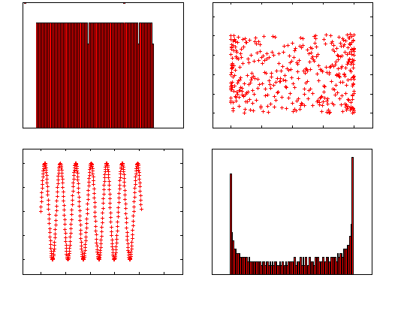
Correlation and MI
R=0.02 MI=1.03 nat
P(X)
X
X
Y
Y
P(Y)
R=0.00₀₂ MI=1.65 nat
X
Y
Slide from I. Guyon, PASCAL Bootcamp in ML
Notes:
We next address the relationship between correlation and MI.
correlation is a measure of linear dependences
mi -- does not require the dependencies to be linear, but there is a price to pay in that it can be expensive.
In upper left and lower right we show the marginal distributions of X and Y, two variables (ignore that we have been using Y as the class).
The boxes in the lower left and upper right are two joint density functions of X and Y (made up).
The lower left has some structure, the upper right does not.
In terms of correlation both look terrible – can’t make a line to explain Y from X or v.v., but MI is able to find that there is a relationship in the one on the lower left.

Slide 14
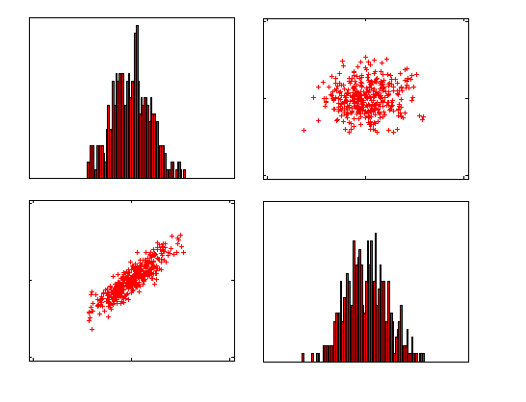
Gaussian Distribution
P(X)
X
X
Y
Y
P(Y)
X
Y
MI(X, Y) = -(1/2) log(1-R²)
Slide from I. Guyon, PASCAL Bootcamp in ML
Notes:
Note that for the Guassian distribtion, there is an exact relationship between correlation r, and MI and is given by this formula but in general it is not this straightforsward.

Slide 15
T-test
μ-
μ+
P(X_{i}|Y=1)
P(X_{i}|Y=-1)
-1
x_{i}
σ-
σ+
Normally distributed classes, equal variance σ² unknown; estimated from data as σ²_{within}.
Null hypothesis H₀: μ+ = μ-
T statistic: If H₀ is true,
t= (μ+ - μ-)/(σ_{within}√1/m⁺+1/m⁻) Student(m⁺+m⁻-2 d.f.)
Slide from I. Guyon, PASCAL Bootcamp in ML
Notes:
What do people do in statistics.
where they use test to determine relevance, e.g. t-test, measures whether there is a sig difference between 2 distr’ns assumed to be normal
if the null hypothesis Ho true then the distribution between the two means (rescaled by the standard error) follows a t-distr’n.
You can do the test, and then if
want a certain risk value that it is relevant, we can use the test.
Or we can use the p-value and rank the features, cutting off at a particular value.
Often people just assume a normal distr’n.

Slide 16

Other ideas for Univariate Feature Selection?
Notes:
Run LTU, select features with large weights
Run decision tree, select features chosen in the decision tree

Slide 17
Considering each feature alone may fail
Guyon-Elisseeff, JMLR 2004; Springer 2006
Notes:
Why consider multiple variables (subsets) together?
Look that two figures that are scatter plots. We have two distributions
Look at the projection onto each axis. Imagine x1 is age, x2 is weight we see no separation, so a univariate feature selection would throw away x2.
X2 alone is irrelevant but together with x1 is good.
Second example, shows that each alone do not give a separation. Together they give a separation (even though its not linear).

Slide 18
Multivariate Filter Methods?
Introduction to Machine Learning and Data Mining, Carla Brodley
Notes:
Can’t really do it because how on earth do we do any kind of approximation of the joint without a ton of data….

Slide 19
Filtering
Advantages:
  Fast, simple to apply
Disadvantages:
  Doesn’t take into account which learning algorithm will be used
  Doesn’t take into account correlations between features, just correlation of each feature to the class label
Introduction to Machine Learning and Data Mining, Carla Brodley
Notes:
Last point can be an advantage if we’re only interested in ranking the relevance of features, rather than performing prediction

Slide 20
Feature Selection Methods
Filter:
Wrapper:
Filter
Selected
Features
All Features
Supervised
Learning
Algorithm
Classifier
Selected
Features
Feature
Subset
Supervised
Learning
Algorithm
Classifier
Feature
Evaluation
Criterion
Classifier
All Features
Search
Selected
Features
Criterion Value
Introduction to Machine Learning and Data Mining, Carla Brodley

Slide 21
Feature
Subset
Supervised
Learning
Algorithm
Classifier
Feature
Evaluation
Criterion
All Features
Search
Selected
Features
Criterion Value
Introduction to Machine Learning and Data Mining, Carla Brodley
Notes:
What can we do here? How should we evaluate each subset????

Slide 22
Feature
Subset
Supervised
Learning
Algorithm
Classifier
Feature
Evaluation
Criterion
All Features
Search
Selected
Features
Criterion Value
Search Method: sequential forward search
A
B
C
D
A, B
B, C
B, D
A, B, C
B, C, D
Introduction to Machine Learning and Data Mining, Carla Brodley
Notes:
We applied sequential forward search in our experiments. For other applications, we have applied other search methods – we have also developed an interactive framework for visually exploring clusters – appeared in KDD 2000
This is a greedy method that may find a suboptimal solution. Take the case where 2
Features alone tell you nothing – but together they tell you a lot.

Slide 23
Feature
Subset
Supervised
Learning
Algorithm
Classifier
Feature
Evaluation
Criterion
All Features
Search
Selected
Features
Criterion Value
Search Method: sequential backward elimination
ABC
ABD
ACD
BCD
AB
AD
BD
A
D
Introduction to Machine Learning and Data Mining, Carla Brodley
Notes:
Abc abd acd bcd

Slide 24
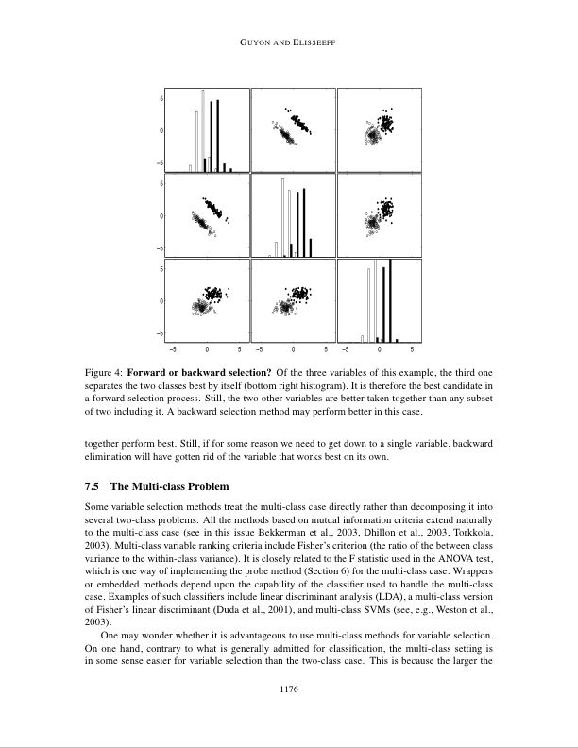
Forward or backward selection? Of the three variables of this example, the third one separates the two classes best by itself (bottom right histogram). It is therefore the best candidate in a forward selection process. Still, the two other variables are better taken together than any subset of two including it. A backward selection method may perform better in this case.
Introduction to Machine Learning and Data Mining, Carla Brodley

Slide 25
Model search
More sophisticated search strategies exist
  Best-first search
  Stochastic search
  See “Wrappers for Feature Subset Selection”, Kohavi and John 1997
Other objective functions exist which add a model-complexity penalty to the training error
  AIC, BIC
Introduction to Machine Learning and Data Mining, Carla Brodley

Slide 26
Regularization
In certain cases, we can move model selection into the induction algorithm
  Only have to fit one model; more efficient
This is sometimes called an embedded feature selection algorithm
Introduction to Machine Learning and Data Mining, Carla Brodley
Notes:
In mathematics and statistics, particularly in the fields of machine
learning and inverse problems, regularization involves introducing
additional information in order to solve an ill-posed problem or to
prevent overfitting. This information is usually of the form of a
penalty for complexity, such as restrictions for smoothness or bounds
on the vector space norm.
A theoretical justification for regularization is that it attempts to
impose Occam's razor on the solution. From a Bayesian point of view,
many regularization techniques correspond to imposing certain prior
distributions on model parameters.
The same idea arose in many fields of science. For example, the
least-squares method can be viewed as a very simple form of
regularization. A simple form of regularization applied to integral
equations, generally termed Tikhonov regularization after Andrey
Nikolayevich Tikhonov, is essentially a trade-off between fitting the
data and reducing a norm of the solution. More recently, non-linear
regularization methods, including total variation regularization have
become popular.
In statistics and machine learning, regularization is used to prevent
overfitting. Typical examples of regularization in statistical machine
learning include ridge regression, lasso, and L2-norm in support
vector machines.
Regularization methods are also used for model selection, where they
work by implicitly or explicitly penalizing models based on the number
of their parameters. For example, Bayesian learning methods make use
of a prior probability that (usually) gives lower probability to more
complex models. Well-known model selection techniques include the
Akaike information criterion (AIC), minimum description length (MDL),
and the Bayesian information criterion (BIC). Alternative methods of
controlling overfitting not involving regularization include
cross-validation.

Slide 27
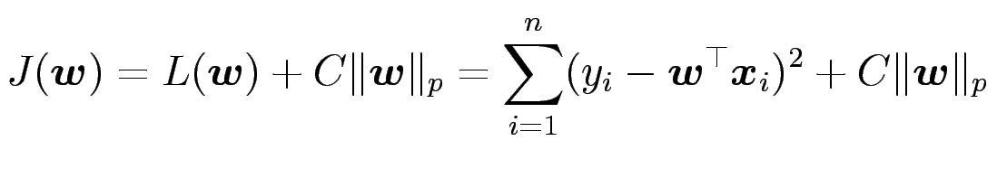
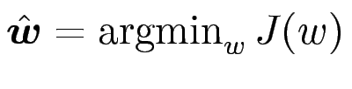

Regularization
Regularization: add model complexity penalty to training error.
for some constant C
Now
Regularization forces weights to be small, but does it force weights to be exactly zero?
  is equivalent to removing feature f from the model
Introduction to Machine Learning and Data Mining, Carla Brodley

Slide 28
Kernel Methods (Quick Review)
Expanding feature space gives us new potentially useful features
Kernel methods let us work implicitly in a high-dimensional feature space
  All calculations performed quickly in low-dimensional space
Introduction to Machine Learning and Data Mining, Carla Brodley

Slide 29
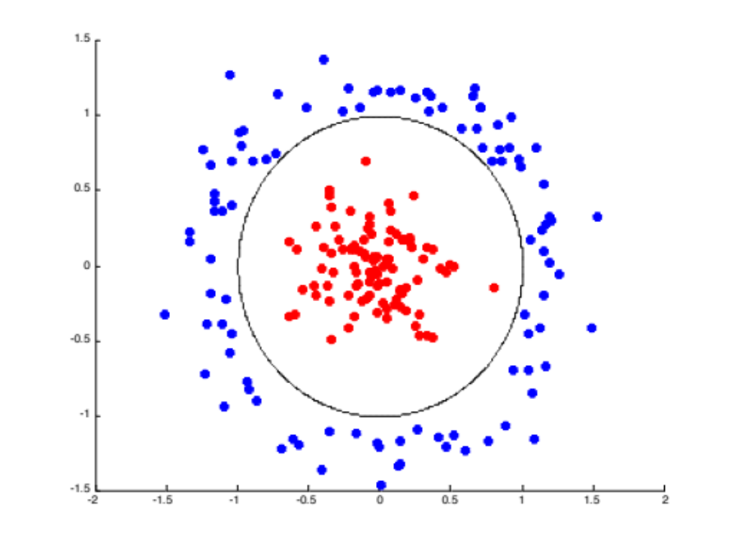
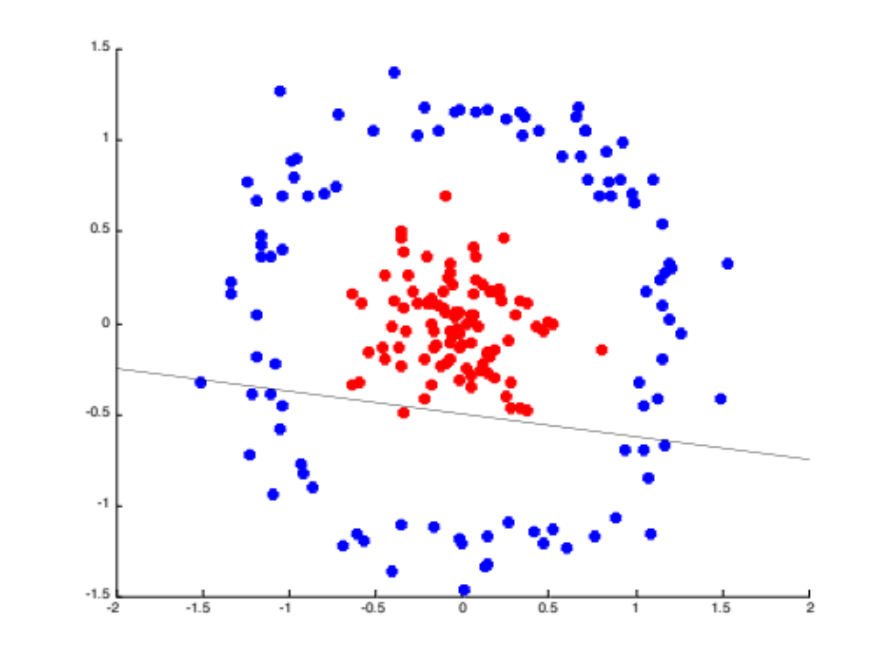
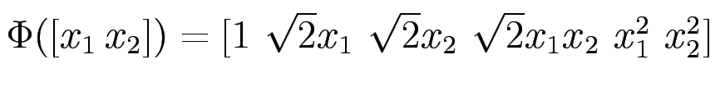
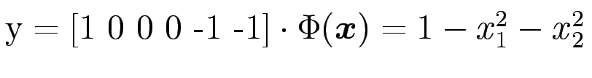
Feature Engineering
Linear models: convenient,
fairly broad, but limited
We can increase the
expressiveness of linear
models by expanding the
feature space.
  E.g.
  Now feature space is R⁶ rather than R²
  Example linear predictor in these features:
Introduction to Machine Learning and Data Mining, Carla Brodley

Slide 30
END OF MATERIAL
Follow up slides require knowledge of ROC and L1, L2 Norms – have not yet covered these ideas in Fall 2012

Slide 31
Individual Feature Relevance
ROC curve
1
μ-
μ+
0
Sensitivity
AUC
-1
0
1
σ-
σ+
1- Specificity
x_{i}
Slide from I. Guyon, PASCAL Bootcamp in ML
Notes:
One simple measure of relevance is the displacement of the two means of the two distributions.
We have a new feature on the right. Note that now it does have some information.
How do we define an algorithm to determine which features are predictive?
Simple idea: use the difference between the means (normalized to account for different ranges of course).
Idea 2: use AUC for single features.
We consider each feature as a “classifier” and then we can set a threshold for the value to say +ive or –ive class, then
Measure the AUC (shows the tradeoff between the sensitivity (error on +ive instances) and the specificity (error rate on –ive instances).

Slide 32
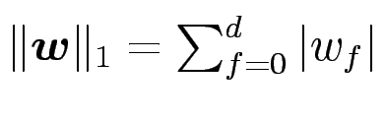
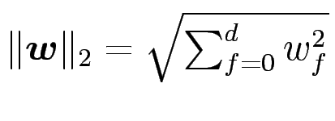
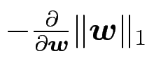
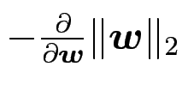
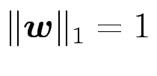
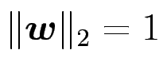
L₁ versus L₂ Regularization
Introduction to Machine Learning and Data Mining, Carla Brodley
Notes:
NEED TO UNDERSTAND THIS STILL
http://www.di.ens.fr/~mschmidt/Software/lasso.pdf

